Slide 1
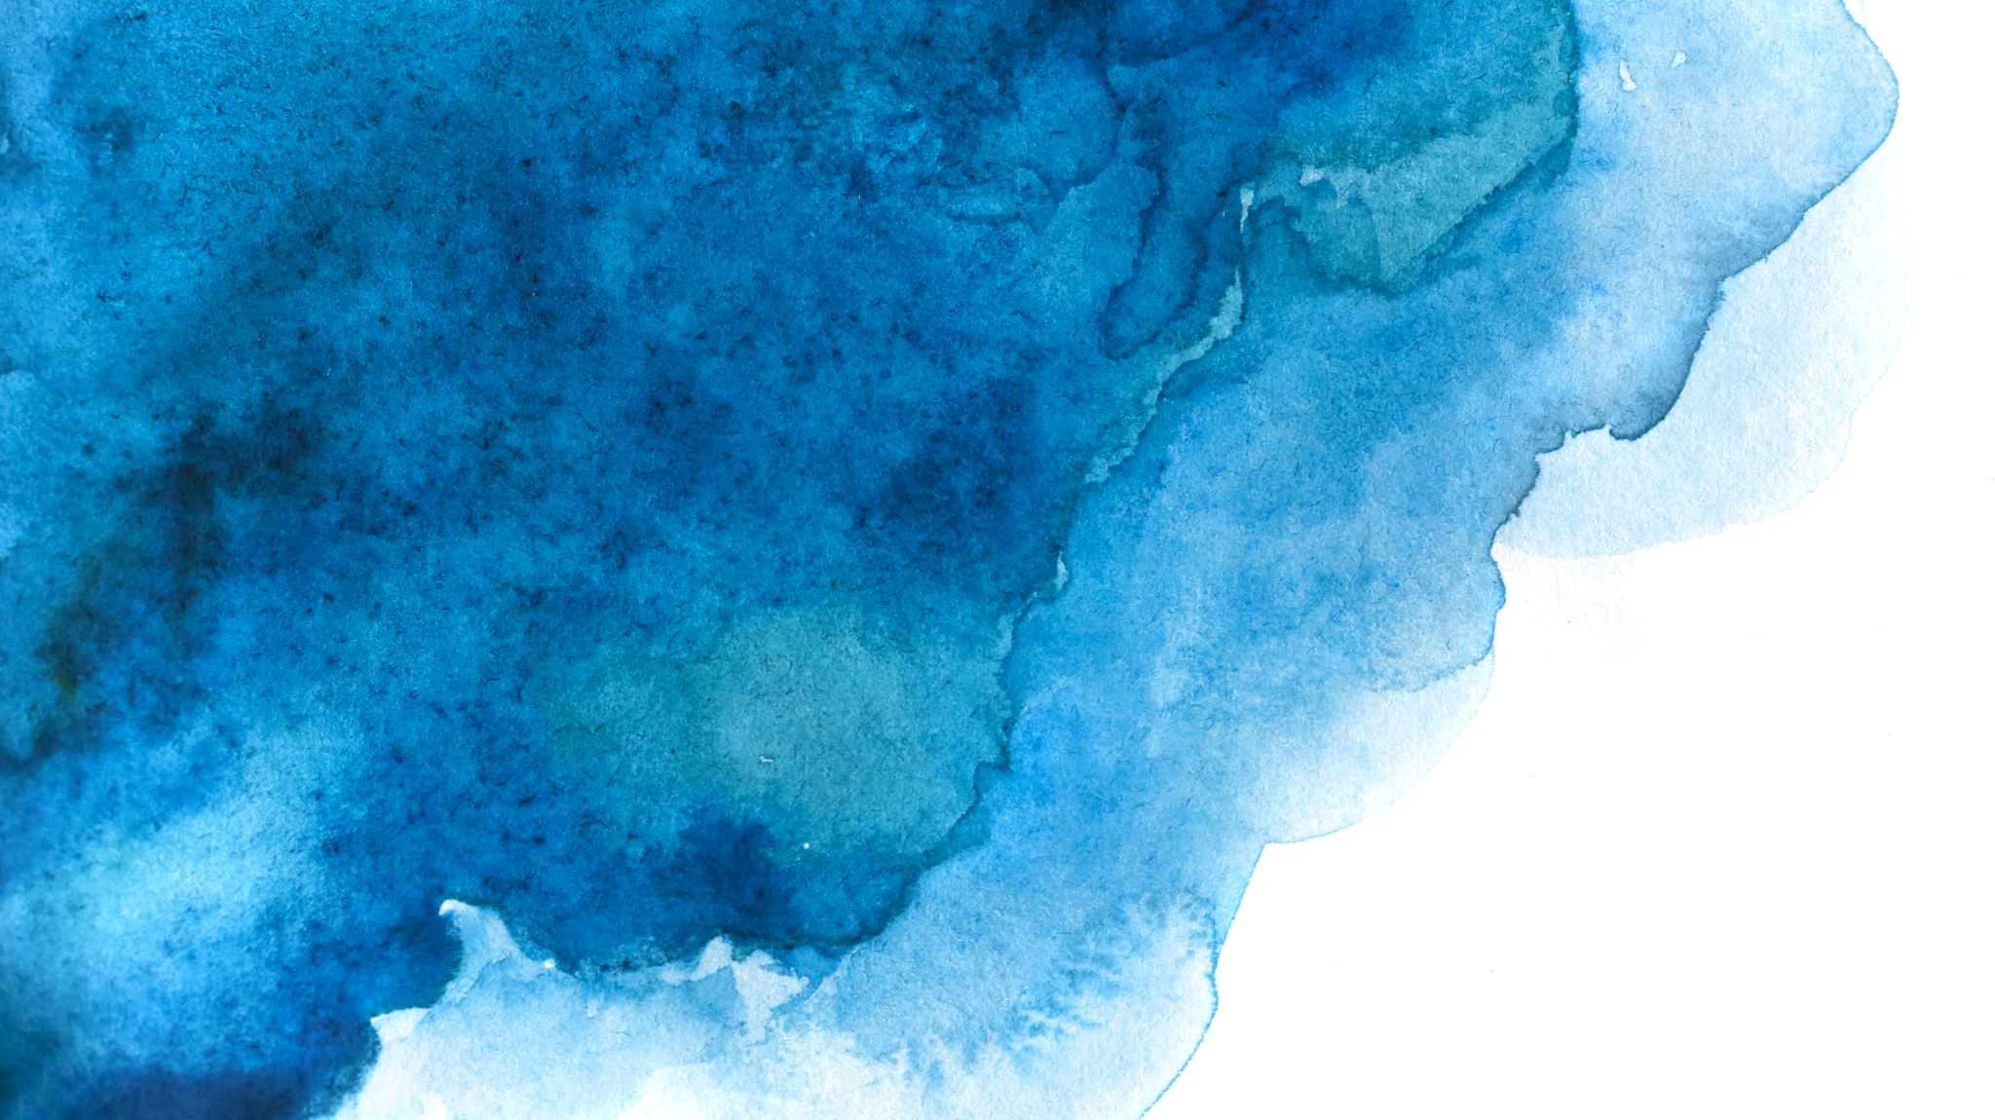
Canvas Widget
In tkinter By shaily jain

Slide 2
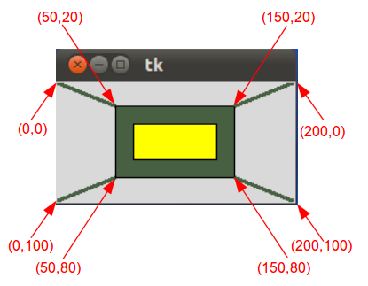
Exploring the Canvas Widget in Tkinter
The Canvas widget in Tkinter is a powerful tool for creating and manipulating 2D graphics within your Python applications. It provides a flexible and versatile canvas on which you can draw shapes, text, and images, and handle user interactions.

Slide 3
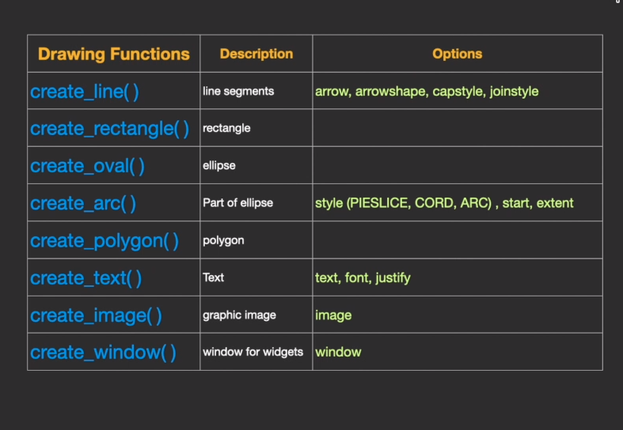
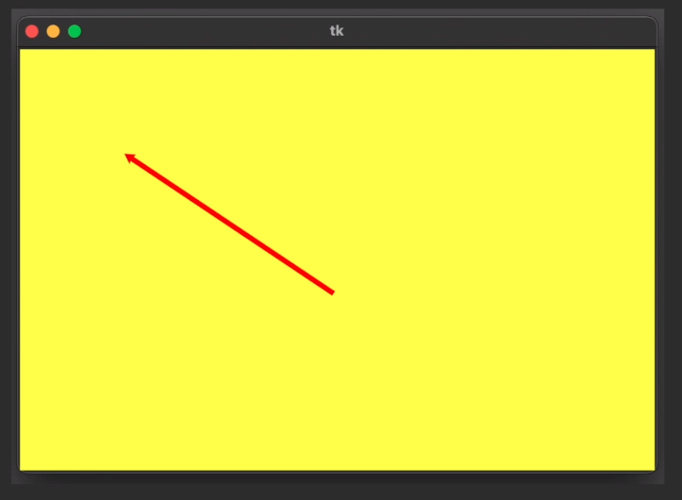
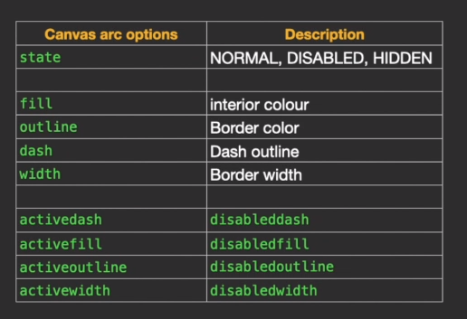
Canvas Widget

Slide 4
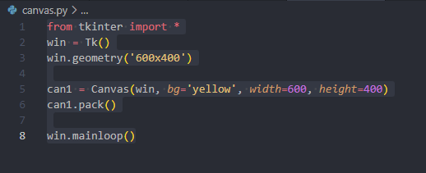
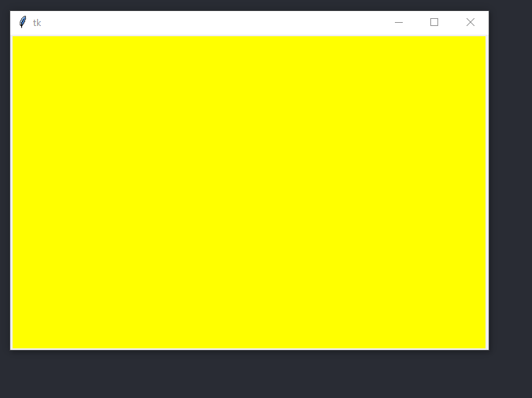

Slide 5
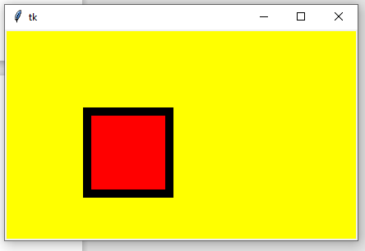
from tkinter import *
win = Tk()
win.geometry('600x400')
can1 = Canvas(win, bg='yellow', width=600, height=400)
can1.pack()
can1.create_rectangle(100, 100, 200, 200, fill='red', outline='black', width=10)
win.mainloop()
Try using create_oval
create_arc
https://tkdocs.com/tutorial/canvas.html

Slide 6
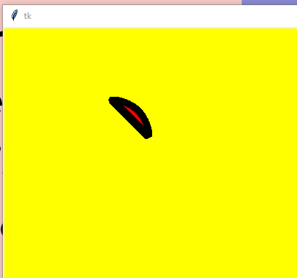
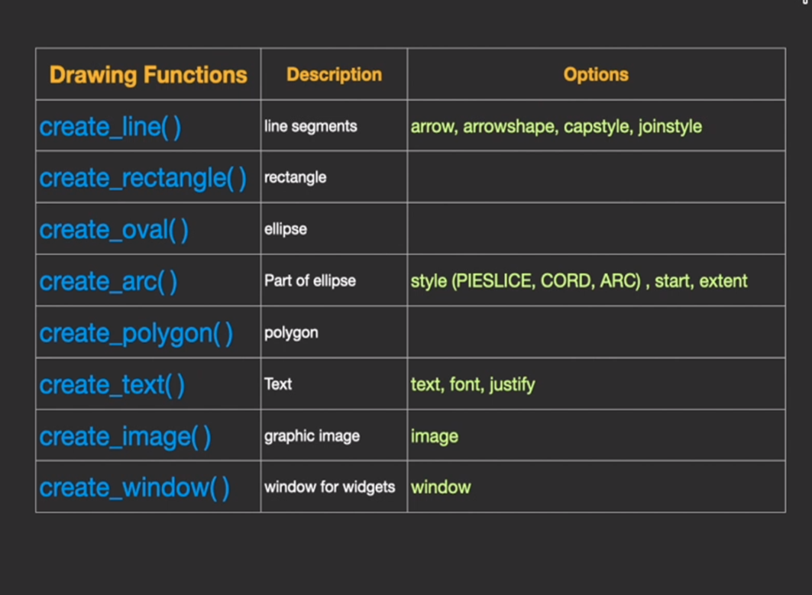
from tkinter import *
win = Tk()
win.geometry('600x400')
can1 = Canvas(win, bg='yellow', width=600, height=400)
can1.pack()
can1.create_arc(100, 100, 200, 200, fill='red', outline='black', width=10, style=CHORD)
win.mainloop()

Slide 7
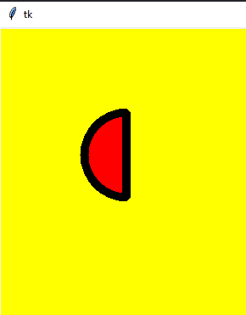
from tkinter import *
win = Tk()
win.geometry('600x400')
can1 = Canvas(win, bg='yellow', width=600, height=400)
can1.pack()
can1.create_arc(100, 100, 200, 200, fill='red', outline='black', width=10, style=CHORD, start=90, extent=180)
win.mainloop()

Slide 8
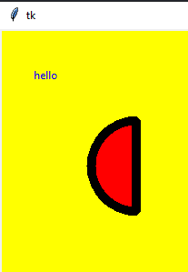
from tkinter import *
win = Tk()
win.geometry('600x400')
can1 = Canvas(win, bg='yellow', width=600, height=400)
can1.pack()
can1.create_arc(100, 100, 200, 200, fill='red', outline='black', width=10, style=CHORD, start=90, extent=180)
can1.create_text(50, 50, text='hello', fill='blue')
win.mainloop()

Slide 9
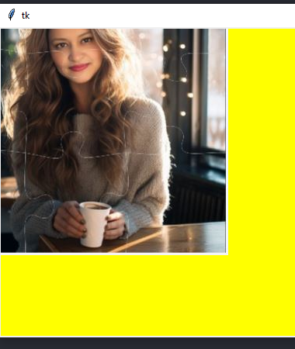
from tkinter import *
from PIL import Image, ImageTk
win = Tk()
win.geometry('600x400')
can1 = Canvas(win, bg='yellow', width=600, height=400)
can1.pack()
can1.create_arc(100, 100, 200, 200, fill='red', outline='black', width=10, style=CHORD, start=90, extent=180)
img1 = ImageTk.PhotoImage(Image.open("IMG5.JPG"))
can1.create_image(100, 100, image=img1)
win.mainloop()
pip install pillow
anchor= nw

Slide 10
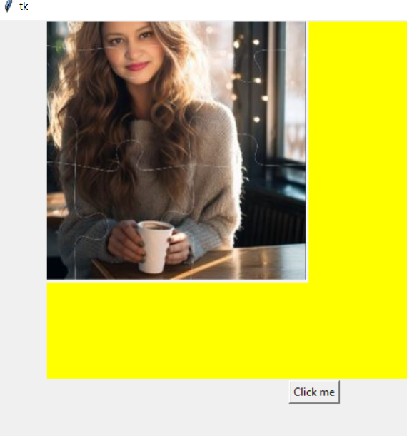
from tkinter import *
from PIL import Image, ImageTk
win = Tk()
win.geometry('600x400')
can1 = Canvas(win, bg='yellow', width=600, height=400)
can1.pack()
can1.create_arc(100, 100, 200, 200, fill='red', outline='black', width=10, style=CHORD, start=90, extent=180)
img1 = ImageTk.PhotoImage(Image.open("IMG5.JPG"))
can1.create_image(100, 100, image=img1)
btn1 = Button(win, text='Click me')
btn1.pack()
win.mainloop()

Slide 11
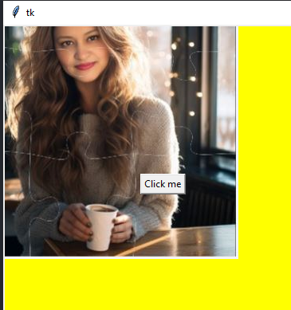
from tkinter import *
from PIL import Image, ImageTk
win = Tk()
win.geometry('600x400')
can1 = Canvas(win, bg='yellow', width=600, height=400)
can1.pack()
can1.create_arc(100, 100, 200, 200, fill='red', outline='black', width=10, style=CHORD, start=90, extent=180)
img1 = ImageTk.PhotoImage(Image.open("IMG5.JPG"))
can1.create_image(100, 100, image=img1)
btn1 = Button(win, text='Click me')
can1.create_window(200, 200, window=btn1)
win.mainloop()

Slide 12
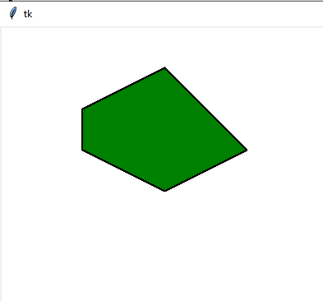
from tkinter import *
# Create the main window
win = Tk()
win.geometry('600x400')
# Create a Canvas widget
can1 = Canvas(win, bg='white', width=600, height=400)
can1.pack()
# Define the coordinates of the polygon
polygon_coords = [100, 100, 200, 50, 300, 150, 200, 200, 100, 150]
# Draw the polygon on the canvas
can1.create_polygon(polygon_coords, fill='green', outline='black', width=2)
# Start the Tkinter event loop
win.mainloop()

Slide 13
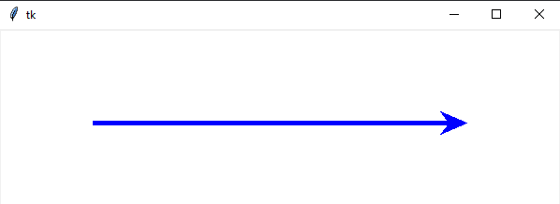
from tkinter import *
# Create the main window
win = Tk()
win.geometry('600x400')
# Create a Canvas widget
can1 = Canvas(win, bg='white', width=600, height=400)
can1.pack()
# Define the coordinates of the line
line_coords = [100, 100, 500, 100]
# Draw the line on the canvas with custom cap style, join style, and arrow shape
can1.create_line(*line_coords, fill='blue', width=5, capstyle=ROUND, joinstyle=BEVEL, arrow=LAST, arrowshape=(20, 30, 10))
# Start the Tkinter event loop
win.mainloop()
Adjust the line_coords list to change the position and length of the line.
You can also experiment with different cap styles (BUTT, PROJECTING, ROUND), join styles (MITER, ROUND, BEVEL), and arrow shapes by modifying the parameters accordingly.

Slide 14
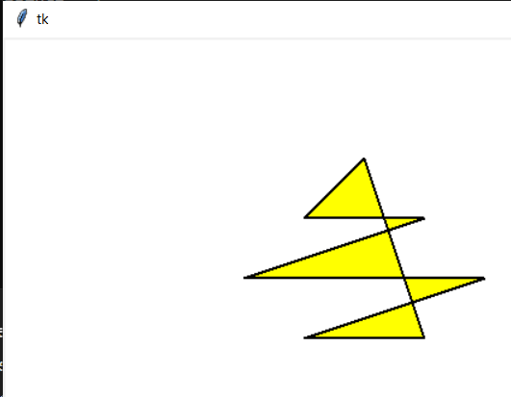
from tkinter import *
# Function to draw a star
def draw_star(canvas, x, y, size):
points = [
x, y - size,
x + size / 2, y + size / 2,
x - size / 2, y + size / 2,
x + size, y,
x - size, y,
x + size / 2, y - size / 2,
x - size / 2, y - size / 2,
x, y - size
]
canvas.create_polygon(points, fill='yellow', outline='black', width=2)
# Create the main window
win = Tk()
win.geometry('600x400')
# Create a Canvas widget
canvas = Canvas(win, bg='white', width=600, height=400)
canvas.pack()
# Draw a star at coordinates (300, 200) with size 100
draw_star(canvas, 300, 200, 100)
# Start the Tkinter event loop
win.mainloop()
Here, x and y represent the center of the star, and size represents the size of the star (the distance from the center to each outer point).
The list points contains 8 pairs of coordinates that define the vertices of the star. The last pair (x, y - size) is repeated to close the polygon and try the shape of the star.

Slide 15
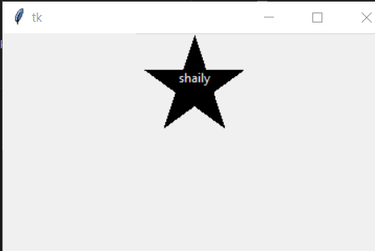
import tkinter
# Named constants
CANVAS_WIDTH = 100
CANVAS_HEIGHT = 100
X1 = 50
Y1 = 1
X2 = 20
Y2 = 91
X3 = 97
Y3 = 35
X4 = 2
Y4 = 35
X5 = 79
Y5 = 91
TEXT_X = 50
TEXT_Y = 35
class MyGUI:
def __init__(self):
# Create the main window.
self.main_window = tkinter.Tk()
# Create the Canvas widget.
self.canvas = tkinter.Canvas(self.main_window, width=CANVAS_WIDTH,
height=CANVAS_HEIGHT)
# Draw the star.
self.canvas.create_polygon(X1, Y1, X2, Y2, X3, Y3, X4, Y4, X5, Y5)
# Write the name
self.canvas.create_text(TEXT_X, TEXT_Y, text='shaily',
anchor= tkinter.N, fill='white')
# Pack the canvas.
self.canvas.pack()
# Start the mainloop.
tkinter.mainloop()
# Create an instance of the MyGUI class.
my_gui = MyGUI()

